Slide 1

Quantum-Ready Now: Federal Migration Strategies and Labs with IBM

Slide 2
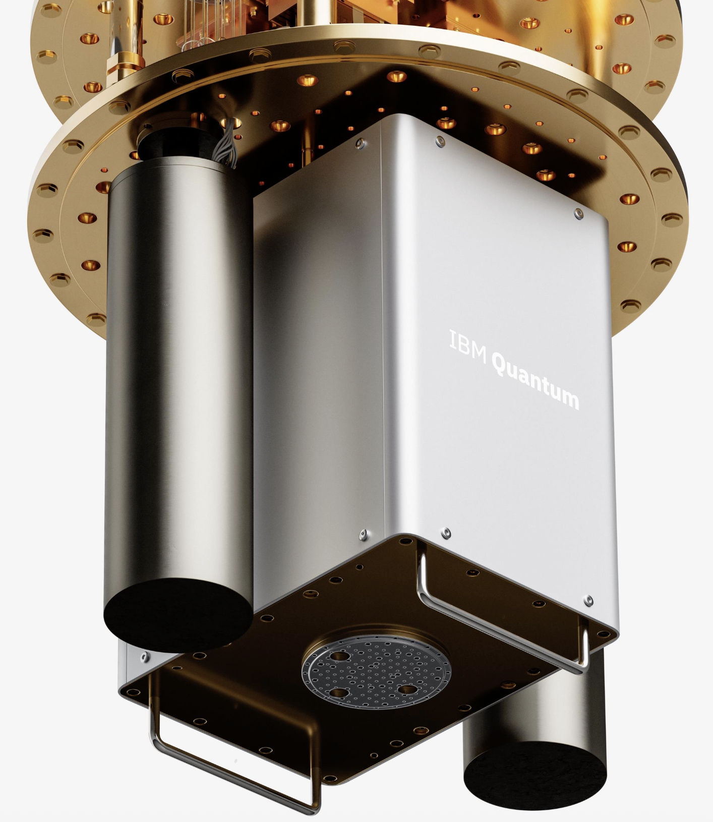

What is this device?
Quantum Chip!
Roadmap to Fault Tolerance:
IBM is scaling towards a massive fault-tolerant machine (Starling) slated for 2029
It will feature 200 logical qubits and the ability to accurately execute 100 million quantum gates
"Q-Day” - between 2030 to 2035, it is predicted that quantum computers can run Shor’s algorithm
https://www.ibm.com/quantum/blog/large-scale-ftqc

Slide 3
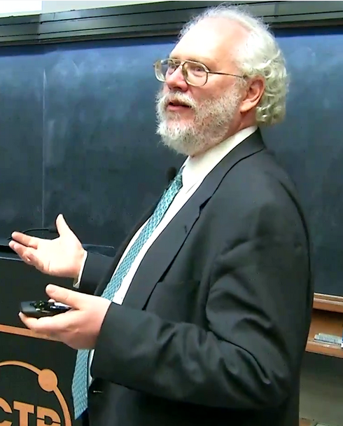
Who is this person?
Shor’s algorithm (1994) shows a quantum computer can factor large numbers—at least 2048 bits long (that’s 617 decimal digits).
On a classical computer, this would take millions of years.
On a cryptographically relevant quantum computer, this would take a few hours.
Notes:
Shor's Algorithm (1994): A landmark algorithm capable of factoring large integers exponentially faster than classical methods, highlighting the potential of quantum computing to challenge current encryption standards.
Quantum Error Correction (1995): Developed foundational codes for protecting quantum information from noise, enabling practical, fault-tolerant quantum computing.

Slide 4
When does the White House Executive Order, Securing the Nation Against Advanced Cryptography Attacks” require federal civilian agencies to submit their Post-Quantum Cryptography (PQC) migration plans—outlining their posture and inventory reviews?
90 Days

Slide 5
How long it will take for an average federal agency to migrate their cryptography algorithms to Quantum Safe?

Slide 6

FTQC THREAT WINDOW
Fault-Tolerant Quantum Computing capable of breaking RSA/ECC
FTQC 2028–2033
2026
2027
2028
2030
2033
2040
Small Enterprise (5–7 yr)
Medium Enterprise (8–12 yr)
Large Enterprise (12–15+ yr)
CNSA 2.0 (2027 new acq → 2033 all NSS)
Large enterprises may still be migrating when quantum computers can break RSA/ECC. Full CNSA 2.0 enforcement across all NSS by 2033 — inside the FTQC window.
Notes:
FTQC = Fault-Tolerant Quantum Computing. Current estimates place a cryptographically relevant quantum computer between 2028 and 2033. Large enterprises starting migration today face 12-15+ year timelines, meaning they will still be migrating when current cryptography becomes vulnerable. This is the central urgency of the PQC migration challenge.

Slide 7
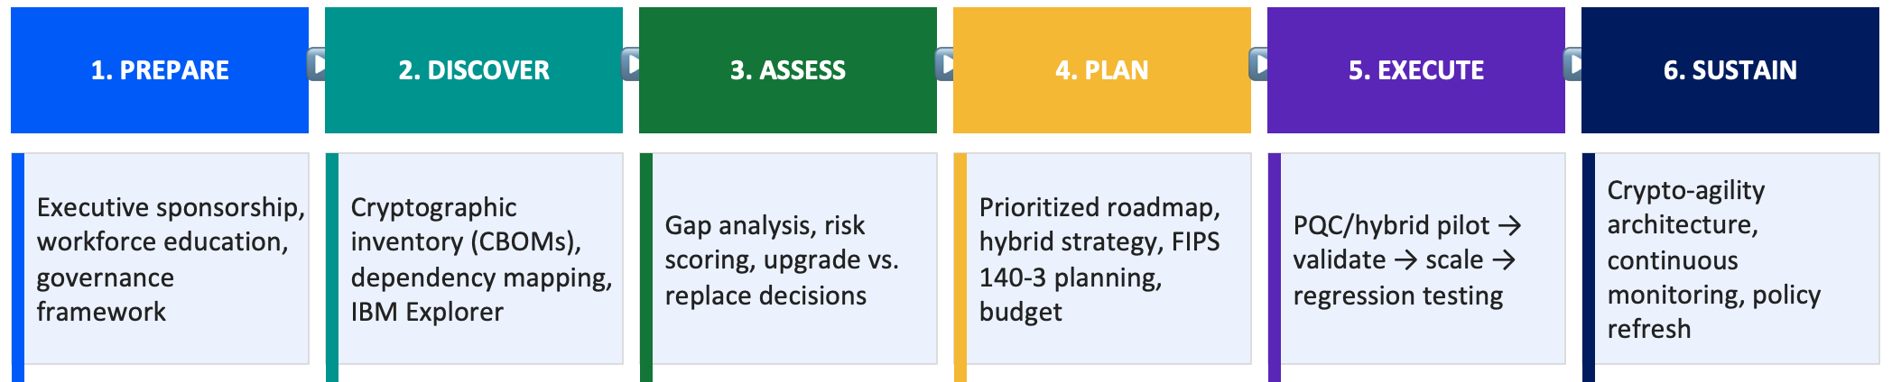
Who can name the phases of a PQC migration strategy?
IBM’s Six-Phase PQC Migration Lifecycle

Slide 8
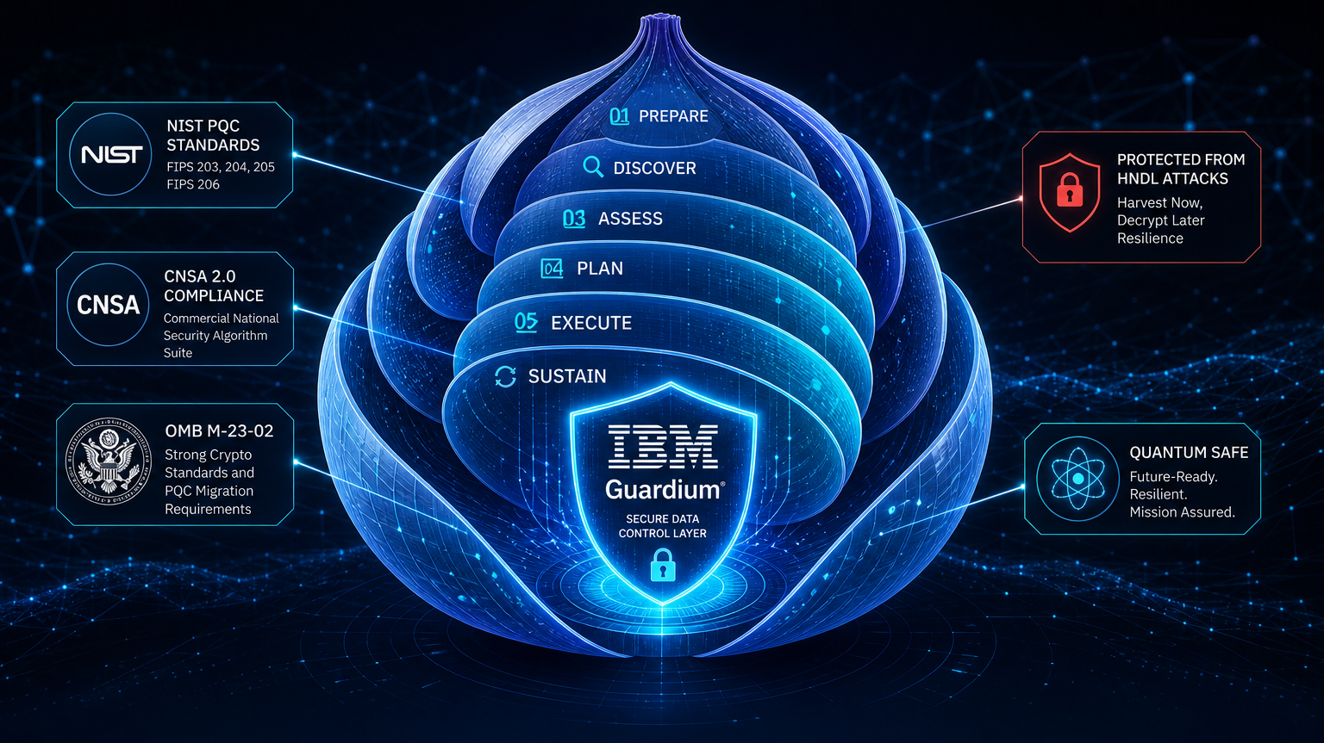

Today’s Event!!!

